Slide 1
DBMS vs File System
BCA Students
Based on: Fundamentals of Database Systems

Slide 2

Introduction
Definition:
A file system is a method of storing and managing data in separate files. Each application maintains its own files, which often results in duplicated data, inconsistency(No Uniformity), and difficulty in sharing information.
File System
Software that organizes how data is named, stored, and retrieved as files and folders directly on a storage device.
•
Stores raw files: .txt, .csv, .jpg, .mp4
•
No built-in understanding of file contents
•
Access via file paths, not queries
Examples: NTFS, ext4, APFS, FAT32
File System vs DBMS — Technical Session
Notes:
Inconsistency is the state of not staying the same, or a situation where two or more facts, ideas, or statements contradict each other and cannot both be true = No uniformity
Software is a collection of instructions, data, or programs used to operate computers and execute specific tasks.
The File System is part of the Operating System. Its job is to store and organize files.
A File-Based System is a way of building applications where all data is stored in separate files like .txt, .csv, or .xlsx, without using a database.
Data storage sources – excel ….others r used by OS

Slide 3

How a File System Works
A hierarchy of directories pointing to blocks of raw bytes on disk
Characteristics
/ (root)
Access pattern
Open file → read/write bytes or lines → close file
/customers/
alice.txt
Structure awareness
bob.txt
None — the file system doesn't know what's inside a .csv or .txt
carol.txt
Querying
/orders/
order_001.csv
No query language — searching means scanning files in application code
order_002.csv
Each file is unrelated — "alice.txt" and "order_001.csv" have no defined link to each other.
File System vs DBMS — Technical Session
Notes:
Instead of using MySQL, you maintain:
Customers.xlsx
Products.xlsx
Sales.xlsx
Employees.xlsx
Whenever the software needs customer details, it opens Customers.xlsx.
Whenever it needs sales information, it opens Sales.xlsx.
That is a File-Based System.
Why was it a problem?
Imagine Rahul changes his phone number.
His phone number appears in:
students.txt
and
fees.txt
and
library.txt
Now you have to update it in every file.

Slide 4
Why Database Systems?
❌ File-Based System
✓ DBMS System
• Data Redundancy (Duplication)
• Data Integration
• Data Inconsistency
• Reduced Redundancy
• Difficulty in Access
• Data Security
• Integrity Issues (Inaccurate data)
• Concurrent Access
• No Security
• Backup & Recovery
• Easy Querying
Notes:
Data Inconsistency means the same information is stored differently in different places.
Consistency = Same everywhere.
Integrity = Correct and trustworthy.
Concurrent access in dbms :
Imagine a bank.
Customer A is depositing ₹1,000.
Customer B is checking the account balance.
Both can use the database simultaneously without causing errors.
Or in a college database:
The Admission Office updates a student's address.
At the same time, the Library checks the student's details.

Slide 5
What is DBMS?
Data : Data are know facts that can be recorded and that have implicit meaning.
Eg: Roll no. :101 , Name : Shelton , Age : 22 , Marks : 95
Database : A database is a collection of related data that represents some aspect of the real world. It is logically organized so that the data can be easily accessed, managed, and updated.
Eg: Roll no. 101 - Name : Shelton - Age : 22 - Marks : 95
Roll no. 102 - Name : Melwin - Age : 29 - Marks : 98
Database Management System (DBMS) :
A Database Management System (DBMS) is software that enables users to define, create, maintain, and control access to a database while providing efficient storage, retrieval, and manipulation of data.
Eg : MySQL, Oracle Database, MongoDB
Notes:
"A Database Management System (DBMS) is software that helps us create, store, retrieve, update, delete, and manage data inside a database."
Books = Database
Librarian = DBMS
Students = Users

Slide 6
What are Database Applications?
A software system that uses a database to store, retrieve, and manage structured data to support business operations and decision-making.
Key Characteristics:
Data Organization
⚡
Efficient Access
✓
Data Integrity
📊
Structured storage
Quick retrieval
Accuracy & consistency
👥
Multi-user
Concurrent access
Notes:
A s/w program -> uses database to -> store, retrieve and manage data for decision making
Data Organization: Stores large volumes of organized data
Data Access: Provides efficient retrieval and modification
Data Integrity: Maintains accuracy and uniformity
Multi-user Access: Supports concurrent users safely

Slide 7
DB Applications in Real World(Examples)
📚
Academic
🛍️
E-commerce
Student records, grades, course management
Products, inventory, orders, customer data
🏥
Healthcare
📱
Social Media
Patient records, medical history, prescriptions
User profiles, posts, connections, messages
🏦
Banking
✈️
Travel/Airlines
Account details, transactions, loans
Bookings, seat reservation, customer info

Slide 8
DBMS Architecture - Introduction
Definition :
DBMS Architecture is the structure that describes the design and components of a database management system, including how data flows between layers and how different components interact.
Key Components:
Schema: Complete description of the database structure (Blueprint)
Instance: Actual data stored in the database at a particular point in time (Actual data)
Users: Different categories accessing the database (DBA, Programmers, End users)
Components: Query processor, storage manager, buffer manager, etc.
Notes:
Design plan
How database is built
Data flow
Access
Components – Main parts

Slide 9
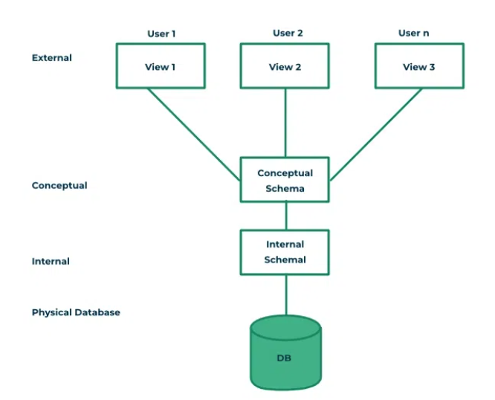
Three Schema Architecture
Notes:
Levels that shows the data flow

Slide 10
Levels of Data Abstraction (Detailed)
(Three Schema Architecture)
EXTERNAL LEVEL
(User View)
Different views for different users.
[ Student sees student info, but not all system data. ]
CONCEPTUAL LEVEL (Logical View)
Overall database structure and entity relationships.
[ Defines what data exists and how it relates. ]
PHYSICAL LEVEL (Storage)
How data is physically stored on disk.
[ File structures and indexing methods. ]
Example: In a College Database, a student application queries student marks.
External Level: Student sees only their marks.
Conceptual Level: Entire schema with Student, Course, Marks entities.
Physical Level: HDD or SSD for fast retrieval.
Notes:
End user - > External view
Application pgrmrs - >External Level + Conceptual Level
Database designers -> Conceptual level
Database Admin (DBA) -> Conceptual + Internal
Data Abstraction means hiding unnecessary details and showing only the information that the user needs.

Slide 11
User | 3-Schema Level | Why?
End Users | External Level (View Level) | They only see the data they are allowed to access.
Application Programmers | External Level + Conceptual Level | They develop applications and decide what data each user can access.
Database Designers | Conceptual Level | They design the overall database structure, tables, relationships, and constraints.
Database Administrator (DBA) | Conceptual Level + Internal Level | They manage the database structure, security, storage, backup, indexing, and performance.

Slide 12
Schema, Instance & Users
Schema
Instance
Description of database structure. Includes table definitions, attributes, types, and constraints. Does NOT change frequently.
Actual data/content in the database at a specific time. Changes frequently with INSERT, UPDATE, DELETE operations.
Database Users:
👨‍💼
🎨
👨‍💻
👤
DBA
Designer
Programmer
End User
Creates schema, security
Database design
Application code
Query & update

Slide 13
Data Independence - Concept
Definition :
Data independence is the ability to change the database schema without affecting the application programs.
Two Types of Data Independence:
Physical Data Independence
Logical Data Independence
Ability to change physical storage structures without affecting conceptual schema or application programs.
Ability to change conceptual schema without affecting external schemas or application programs.

Slide 14
Basic Components of DBMS
A DBMS consists of several interconnected components that work together to manage data efficiently:
🔍
Query Processor
💾
Storage Manager
🔄
Transaction Manager
Parses SQL, optimizes, executes queries
Manages file organization & indexing
Ensures ACID properties , uniformity
📦
Buffer Manager
🔐
Security Manager
♻️
Recovery Manager
Manages memory buffers & disk I/O
Authentication & authorization
Backup, logging & failure recovery
Notes:
Parse = Read + Understand + Break into parts
Query processor - clerk
Storage manager – record room
Transaction manager – rule enforcer (now or never)
Buffer manager – office table (frequent data)
Security manager – door guard
Recovery manager – backup guy

Slide 15
Summary & Key Takeaways
Database Applications:
Software systems that use databases to manage structured data for business operations.
Data Independence:
Ability to change schema without affecting applications. Two types: Physical and Logical.
DBMS Architecture:
Consists of 3 schema levels (External, Conceptual, Physical) with multiple interconnected components.
Schema vs Instance:
Schema is the structure (static), Instance is the data (dynamic, changes over time).

